Slide 1
UNIT 4: CHANGING EUROPEAN WORLD
EXAM REVISION

Slide 2
FORCES IN HISTORY
The impact of the following forces should be considered, where appropriate, throughout the unit:
economic
external forces/international relations
ideas
leadership
political
social/cultural.

Slide 3
OVERVIEW
an overview, as background, of the nature of the origins and early development of the Cold War to 1948, including the ideological, cultural and political differences between the United States and the Soviet Union; and the significance of the Truman Doctrine, the Marshall Plan and Berlin Blockade’
Youtube\THE COLD WAR - PART 1 From World War to Cold War.mp4

Slide 4
Youtube\2 Truman Doctrine and Marshall Plan.mp4

Slide 5
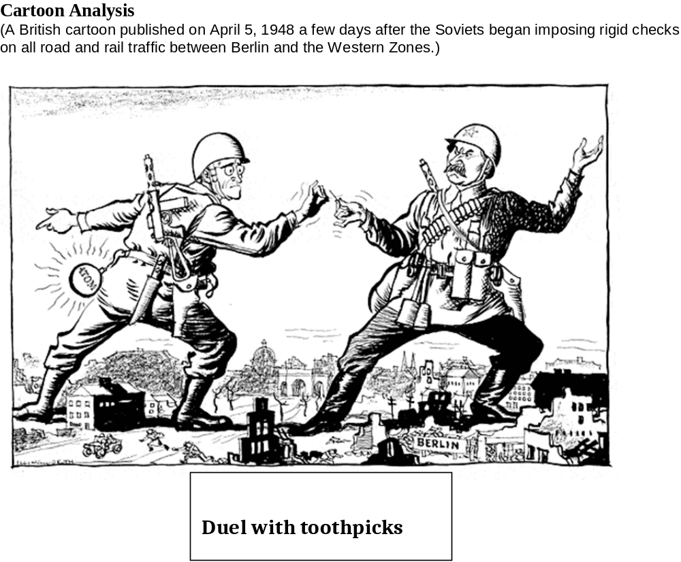

Slide 6
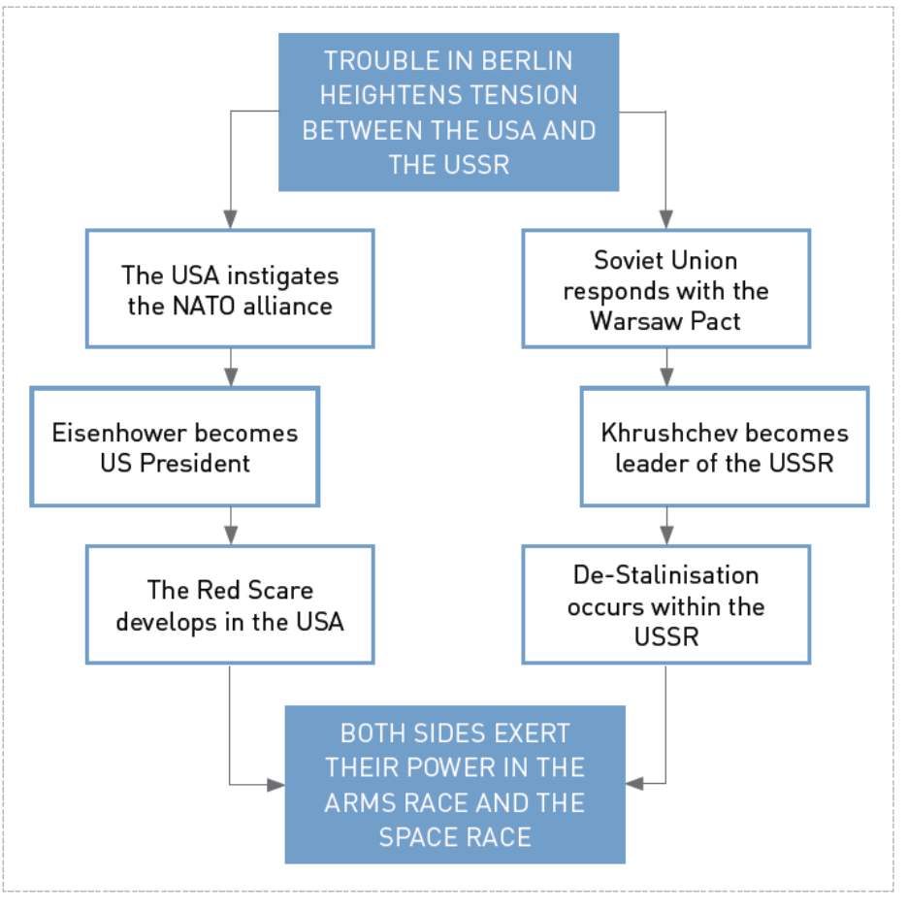

Slide 7
IDEAS
the significant ideas of the period, including communism, capitalism, democracy, containment, peaceful co-existence, détente, glasnost and perestroika, nationalism, and re-integration
Youtube\Glasnost and Perestroika.mp4

Slide 8
PAST ATAR EXAM QUESTION
Question 13 (25 marks)
Assess the significance of one key idea of the time period.
Question 13 attempted by 795 candidates Mean 14.09(/25) Max 25.00 Min 0
There were some choices of ideas by the candidates that were difficult to sustain as an idea that could be directly applied to the elective, either because they were much too vague, or seemed to be an attempt to fit a prepared answer into a question.
Many candidates also did not clearly identify their idea in the introduction, or discussed multiple ideas rather than a single idea as required by the question. While not constrained to the list of ‘ideas’ in the syllabus, the selected idea needed to be conceptually similar to the ones in the syllabus, something that perhaps needs to be emphasised? The best responses tended to use one of the ideas from the syllabus. Some choices of idea seemed to be chosen ‘after the fact’ in that candidates were determined to write a prepared answer, and then worked out what ‘idea’ might suit that prepared answer, which led to some interesting notions of ideas.

Slide 9
MARKERS’ NOTES:
Candidates need to assess the significance of their chosen idea to ensure higher marks. Candidates who write a narrative about an idea should score lower marks as they have not answered the entire question.
Key ideas may include one of the following:
• communism • capitalism
• democracy • containment
• peaceful co-existence • détente
• Glasnost • Perestroika
• democratisation • nationalism
• re-integration.

Slide 10
CHANGING NATURE OF THE COLD WAR
the evolving nature and character of the Cold War in Europe from 1948 through to détente, including the impact of the arms race, the space race, and threat of nuclear war; the 1956 invasion of Hungary; the Berlin Wall; the Cuban Missile Crisis; the Prague Spring and the Brezhnev Doctrine; the new Cold War of the 1980s; and the collapse of communism 1989–1991
Youtube\Hungarian Revolt 1956.mp4
Youtube\The relationship between the USA and the USSR in the 1980s.mp4

Slide 11
PAST ATAR EXAM QUESTION
Question 14 (25 marks)
Analyse the reasons for and consequences of key conflicts in Europe during the 1950s and 1960s.
Question 14 attempted by 274 candidates Mean 13.53(/25) Max 22.00 Min 0
The need to keep the response within the 1950s/60s was a problem for some candidates; the Berlin Blockade, for example, was outside this time period. The consequences were often somewhat glib or lost in a focus on the narrative.

Slide 12
MARKERS’ NOTES:
Candidates may choose to assess one or more conflicts and the number of conflicts chosen does not automatically influence their mark. However, higher marks should be awarded to candidates demonstrating the ability to analyse (examine in detail the relationship between causes and consequences in the context of the 1950s and/or 1960s) than to those who simply outline what happened, so it may be likely that candidates choosing one conflict gain higher marks.
Key conflicts may include:
• East Berlin and East Germany 1953 • Hungary 1956
• Berlin 1958–61 • Prague Spring 1968
• the impact of the arms race and the threat of nuclear war
• the space race.

Slide 13
AFTER THE COLD WAR
significant developments that followed the end of the Cold War in 1989, including the break-up of the Soviet Union and the resultant changes in the politics and economics of the Soviet Union; the reunification of Germany (the Two Plus Four Treaty 1990); the break-up of the former Yugoslavia; and the changing role of North Atlantic Treaty Organisation (NATO) from Cold War Alliance to the
NATO-Russia Council

Slide 14
PAST ATAR EXAM QUESTION
Question 13 (25 marks)
Analyse the consequences of the collapse of communism after 1989 on the European region.
Question 13 attempted by 374 candidates Mean 14.75(/25) Max 24.5 Min 0.5
Some candidates produced very effective responses to this question that looked at a variety of elements of Europe in the 1990s that could be clearly and explicitly connected to the fall of Communism. However, in some cases the essay became a narrative of Europe in the 1990s, with connections back to the collapse of communism gradually disappearing as the essay progressed. Some candidates also spent a great deal of time explaining how the collapse of communism occurred and therefore much less time discussing the effects of the collapse after 1989.

Slide 15
MARKERS’ NOTES
Answers may include:
• a declaration of the end to the Cold War
• fall of the Berlin Wall and subsequent reunification of Germany
• the dissolving of the WARSAW Pact
• the dissolving of the Soviet Union
• the splitting, both peacefully and not so peacefully, of countries such as Yugoslavia and Czechoslovakia
• numerous Eastern Bloc countries joining NATO and the EU leading to stronger social and economic integration across Europe as a whole.

Slide 16
EUROPE
the development of European governance and extension of the ‘European Union’, including the European Economic Community (EEC) (1958), the Maastricht Treaty (1992), the European Union (1993), the Eurozone (1999)

Slide 17
PAST ATAR EXAM QUESTION
Question 12 (25 marks)
Assess the importance of formal alliances and treaties in shaping the European region during the time period.
Question 12 attempted by 440 candidates Mean 13.85(/25) Max 22 Min 0
Responses to this question often became, in effect, a list of various treaties/alliances that existed throughout the period, written in the form of a series of short comments about that treaty/alliance, and then perhaps a quick reference to its effects. As a result, many essays lacked any real flow or connection to a single argument. There were some very detailed responses though that focused on treaties and alliances that underpinned the development towards a European Union, which allowed for connections to be made between the different treaties and their impacts on Europe.

Slide 18
MARKERS’ NOTES
Answers may include:
• NATO
• Two plus Four Treaty (re-unification of Germany)
• the EEC
• the Maastricht Treaty
• the EU
• the Eurozone.
For higher marks candidates should explain the reasons for these alliances and treaties, and the significance of the treaty in shaping Europe’s broader foreign policy, relationships with the non-European countries and changes to the region itself.

Slide 19
CHANGING WORLD ORDER
the changing nature of world order in the period 1989–2001, with specific reference to the place of Europe and the European nation states within that world order

Slide 20
PAST ATAR EXAM QUESTION
Question 12 (25 marks)
Evaluate the changing nature and consequences of the European world order in the period 1989–2001.
Question 12 attempted by 169 candidates Mean 14.86(/25) Max 21.50 Min 0.00
This question was more popular than expected with some good answers. However, there was too much reference to 1980s ideas and events such as Glasnost and Perestroika (and rather than just using this information to explain the changing nature of Europe from 1989, it was stand-alone material).
There was also a tendency to simply describe different elements of Europe in the 1990s, rather than focus on actually evaluating how the nature of Europe was changing and the consequences of that. Consequences was perhaps the weakest part of the responses and many candidates didn’t discuss these at all, or did so in very simplistic terms, such as Europe now being ‘united’.

Slide 21
MARKERS’ NOTES:
Candidates need to evaluate – ‘appraise carefully’ – to make a considered judgement about the place of Europe in the changing world order 1989–2001 and the consequences of those changes.
Answers may include:
Changing Europe 1989–2001: Europe in transition:
• the re-unification of Germany
• the break-up of the USSR
• the break-up of Yugoslavia
• the changing role and expansion of NATO
• economies of Eastern Europe
• changes in the EU – role and expansion.

Slide 22
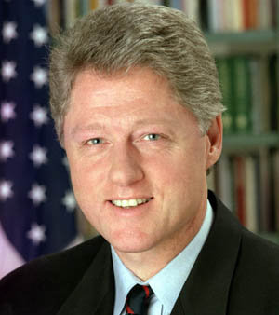
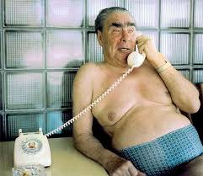
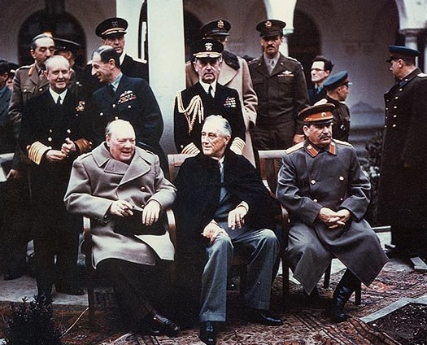
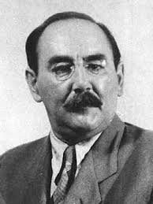
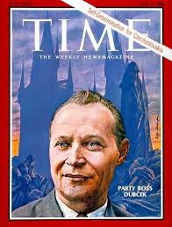
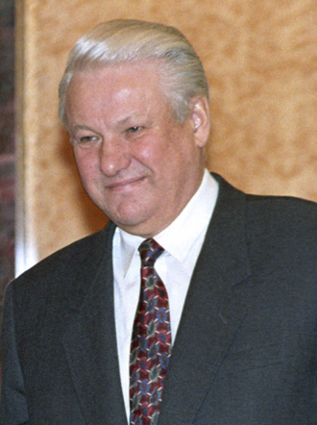
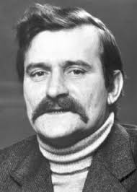
SIGNIFICANT PEOPLE
the role of significant political leaders throughout the period

Slide 23
PAST ATAR EXAM QUESTION
Question 14 (25 marks)
Evaluate the impact of Khrushchev’s leadership on the nature and character of the Cold War in Europe.
Question 14 attempted by 471 candidates Mean 14.22(/25) Max 22.5 Min 0.5
This was the most popular choice of question but some candidates had difficulty articulating Khrushchev’s effect on the nature of the Cold War and focused instead on describing his political ideas and actions. Many candidates discussed the Cuban Missile Crisis at length.
Other candidates seemed to have been hoping for a different leader and used Khrushchev as a launching point for an essay on how Gorbachev had a bigger impact – which was not the focus of the question. Stronger answers really engaged with the idea of Khrushchev having a mixed effect, differentiating between the intentions of policies such as Peaceful Coexistence in reducing tensions and the reality of his somewhat impulsive nature and rhetoric, which actually heightened tensions.

Slide 24
MARKERS' NOTES:
Candidates may choose to argue that despite expressed intentions to ‘peacefully co-exist’ with the West, Khrushchev was by in large ineffectual in achieving this aim as he had to adhere to the wishes of his hard line communist colleagues which culminated in the Berlin Wall and the Cuban Missile Crisis.
They may also state that Khrushchev was not necessarily interested in peaceful co-existence, but peaceful competition – as evidenced by the arms and space races and the propaganda war that still raged whilst he was President.
For higher marks candidates could evaluate the significance of the impact of Khrushchev’s leadership by placing them in the wider context of the Cold War.

Slide 25
Youtube\Cold War You Tube Clips\USA vs USSR Fight! The Cold War Crash Course World History 39.mp4

